Slide 1
Power Law Recession, gammainc errors,

Slide 2
TO DO
General climate classification
relook at climate classification.R and incorporate Xue’s indeces in classification; compare climate classification.R’s classifications into snow/no snow and seasonally dry/not seasonally dry with what Xue’s indeces would do
Code up Schaefli’s snow dominated catchments (requires hypsographic curve and z* calibration…)
Lit review of how pdfs are treated in seasonal climates beyond Marc’s work. Can any other method be applied to ours?
Marc’s seasonally dry stuff
Find a and b recession constants instead of guessing
Check whether pdf(qds) match up in NSE calculations.
Check the Testing Marc Seasonally Dry.R code for holes
In general, NSE is very sensitive, perhaps due to fast variation in pdf value at lower qd values. Consider how positioning of points, rather than a real change in pdf agreement, will impact NSE.
Use numeric pdf for dry season going forward; if have time, do these less important things:
figure out why analytic1 performance changes with number of breaks in histogram
re-derive analytic2 equation, which is completely off

Slide 3
(Schaefli et al., 2013)
Snow-dominated pdfs for “zone I and II catchments” – i.e. they are affected by multiday snow storage, but the snow melts within a season (no glaciers)
Need two new parameters to build on original Botter:
A*: this is found using A*= A * P(Z > z*). The P(Z > z*) means portion of basin that is above a threshold altitude z*, and this P value can be found using the hypsographic curve (which shows the portion of land that exists at various elevations in a basin). To determine z*, the method uses calibration. Once all other parameters are found, adjust z* to fit the observed pdf. NEED TO RETURN TO THIS because need to find hypsographic curve using ArcGIS? Also, what is the use of having to calibrate z* in ungauged basins? Can there be another way to find z*, like relations between elevation and temperature?
kD: this is from tau_D, which is the mean duration of periods with temperatures less than 0 Celsius
The regular (summer) recession will be k, and they calculated it using Brutsaert-Nieber 1977, using Q below 90% of the summer flow quantile.
Did they find precip statistics from the responsive area only or for the whole area?

Slide 4
Gammainc errors
For all seasons, gammainc is used in lambda calculation. The “z” in this case is gam = gamp*S. gam is large when there are very small storm events and very large storage, which happens in Gauge 11468500 in the summer (Etm = 8cm/d, lambdap = 0 to 0.07, gamp = NA sometimes, up to 100; S = 151 cm; k = 0.25). This makes gam too high, which makes lambda very low.
For dry seasons, gammainc is used with two “z” values as in Marc’s paper. The “secondTerm” can’t be too high, but can’t know secondTerm accurately until b is found. Problem gauge: 10259000
Based on Appendix A, Marc meant (-arTd)^(1/r) NOT –(arTd)^(1/r) as in equation 13. The second (wrong) expression would give (-Num)^(-Num) if r < 0: for this to not be NaN, the exponent must be an integer.
When we encounter the “z is too large” in gammainc for Gamma3 and Gamma4 functions in numeric PDF, and in the gammainc call in analytic1, turn the secondTerm into 650 (just like for the gam value in lambda calculation) – this solves the problem.
Finally, lambdap cannot equal zero in the lambda calculation. If it does, then use the seasonally dry stuff.
Value of b | Gamma functions 1&2 or 3&4 | Notes
0 < b < 0.4 | Gamma3 and Gamma4 (r > 0) | The “secondTerm” here isn’t too high, no gammainc error
0.4 < b < 1.01 | Gamma3 and Gamma 4 (r > 0, or the other conditional is satisfied briefly for b > 1) | The “secondTerm” is too high (i.e. > 650), so forced secondTerm to 650. this is ok because at this point, the exact value of the secondTerm doesn’t significantly change value of gamma function (see next slide with graph)
b > 1.01 | Gamma1 and Gamma 2 | The “secondTerm” here is simply gamQ*qd, which is never too high.

Slide 5
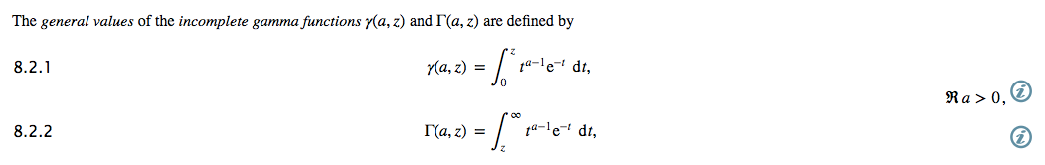
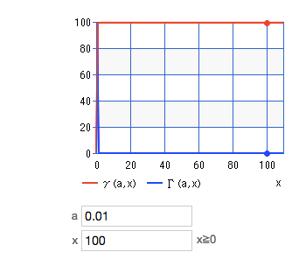
Gammainc function: equations and graphs
At large values of x, both the upper and lower incomplete gamma functions even out.
The value of a changes the location of the asymptote, but doesn’t change the evening out shape.
Incomplete Gamma calculator and graphing: http://keisan.casio.com/exec/system/1180573447

Slide 6
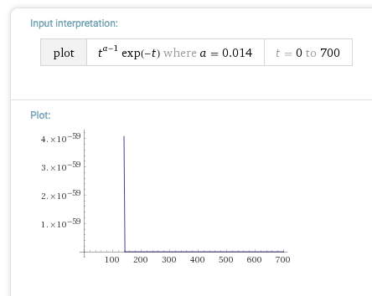
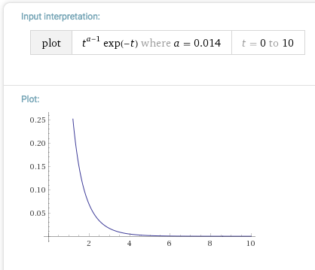
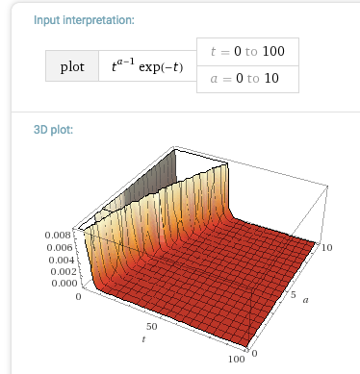
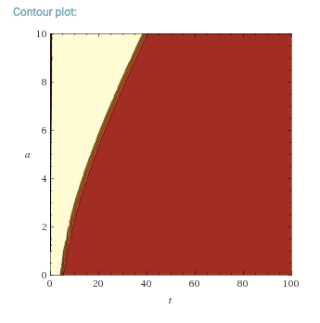
Gammainc function: equations and graphs
At larger values of t, the function tends to even out – so the area under the curve at larger t doesn’t change as much for large t. justifies setting all large z (or x) values to 650?
In Wolfram Alpha, ‘t’ is the variable over which we integrate from 0 to z (or x) in lower incomplete function. At a = 0.014, gammainc breaks down around z = 700

Slide 7

Finding power law recession parameters (a,b)
Dave’s 2017 HESS paper on event-scale power law recession analysis
Looks at different ways to do event scale power law recession analysis, concluded that using nonlinear regression and only counting concave up recession gave best result
Studied CA and Oregon basins, which had a = 0.05 to 0.5 and b = 1.2 to 2.5
There are two steps for recession analysis: (1) recession extraction, and (2) fitting recession to a power law
There are two ways to approach recession analysis: (1) “lumped” method (like Brutseart and Nieber 1977, Vogel and Kroll, 2012, Kirchner, 2009) which just plots log(Q) vs log(-dQ/dt) and finds slope and intercept. Don’t need to figure out start and end days of recession. (2) event-scale recession analysis, which requires deciding on a start and end to recession in addition to a fitting technique
Fitting methods: linear regression of binned collection (Kirchner 2009, Parlange et al 2001); linear regression of raw collection (Biswal and Marani, 2010 and Brutsaert and Nieber, 1977)
Read all the papers Dave mentioned!
Dave’s recession online tool: https://github.com/daviddralle/tethysapp-recession_analyzer
This app isn’t available yet; code looks complicated – sent me one for calculating k before, but doesn’t calculate a and b

Slide 8
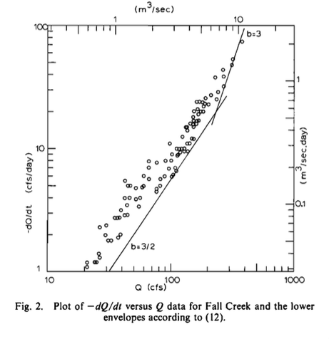
Finding power law recession parameters (a,b)
(Brutsaert and Nieber, 1977)
plot log(-dQ/dt) on y axis and log(Q) on x axis. Then slope is equal to b, and the intercept is log(a)
dQ/dt = [Q(t) – Q(t-1)]/delt
Q = [Q(t) + Q(t-1)]/delt
Ways to avoid overland flow: (1) find the graphical lower envelope of dQ/dt, or (2) wait for 5 days after recent rainfall.
Follow this method for now – and use rainfall to help with determining when groundwater dominates (instead of the lower envelope idea)

Slide 9
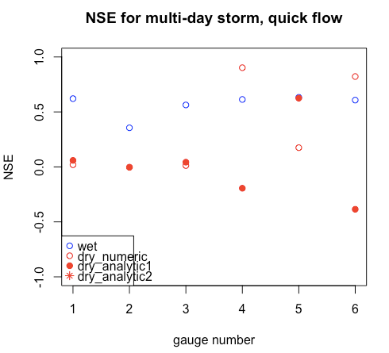
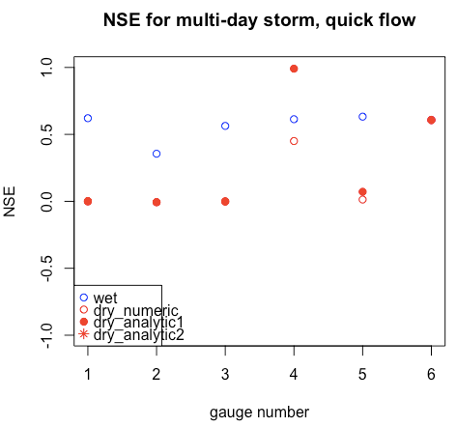
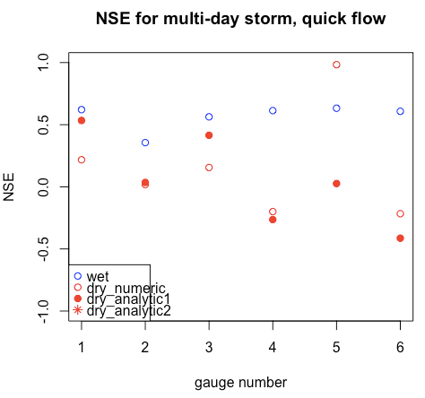
R code: power law recession and then FCN_powerRecession.R (which his used in Testing Marc Seasonally Dry.R)
Linear regression calculation of a and b, using log(-dQdt) vs. log(Q)
Ignore a certain number of days after rain to allow for overland flow (overlandFlowDays)
Ignore when dQdt > 0 (i.e. increasing streamflow)
Calculate using Q and P from each year’s dry season only, then take median or average?
The value of a is 10x larger than what Dave’s paper indicates. The value of b is fine. Units: a is in 1/day and b is unitless. Check a and b values by calculating recession and comparing to data.
Looking at NSE’s sensitivity to a:
a*10
a/10
a

Slide 10
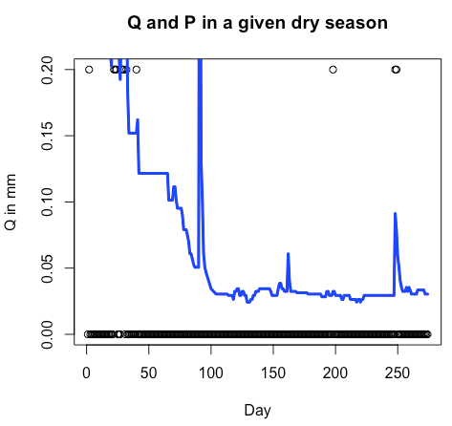
Recessions (a,b)
What to do with “chunky” Q records – avoid them? (already took only dQdt < 0, so perhaps have already accounted for it)
Concern: these timeseries don’t really follow an overall exponential decline, sometimes have significant (if temporary) peaks in middle and end of season. Need to improve Td delination, or just ignore this error?
Changed FCN_powerRecession.R to include only consecutive recession stretches longer than a certain number of days. Otherwise there are times where a single day counts as a recession.

Slide 11
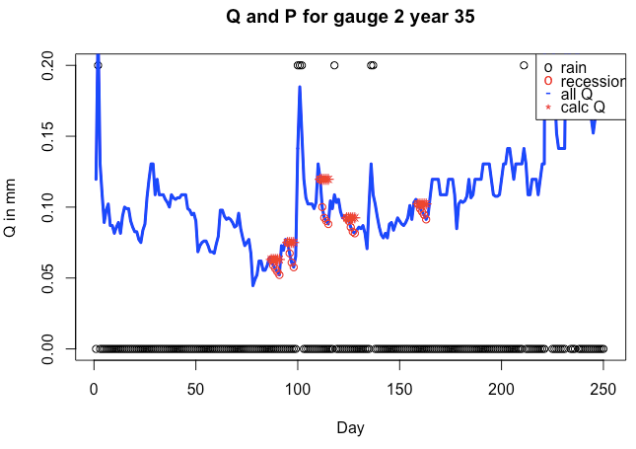
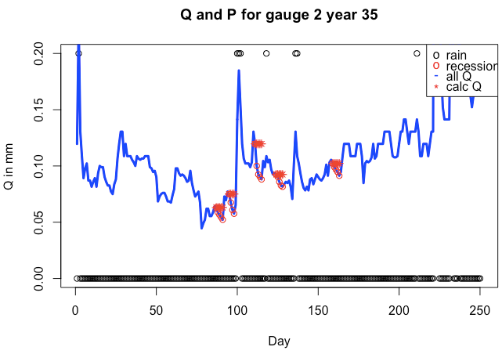
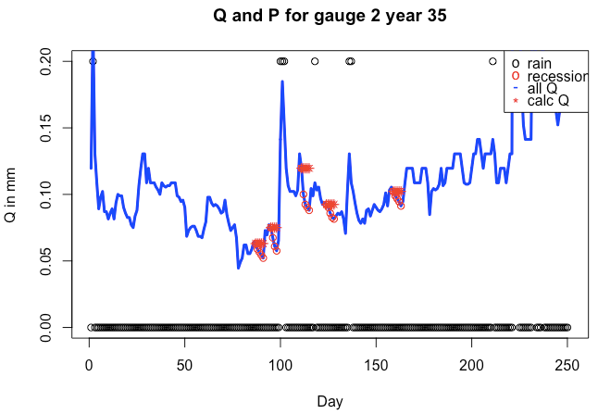
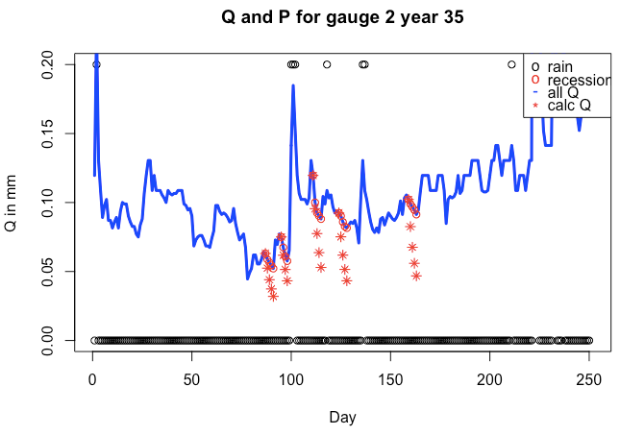
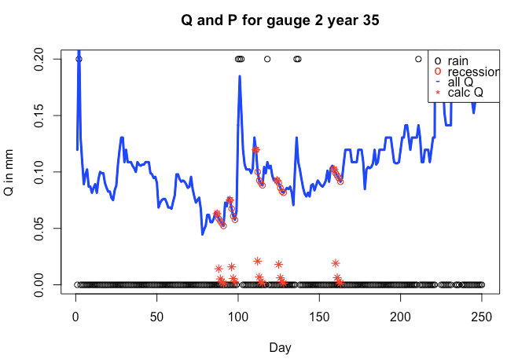
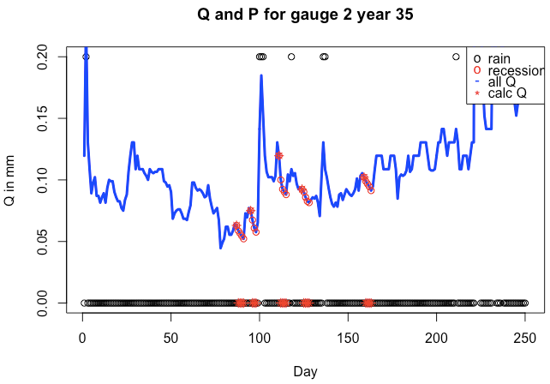
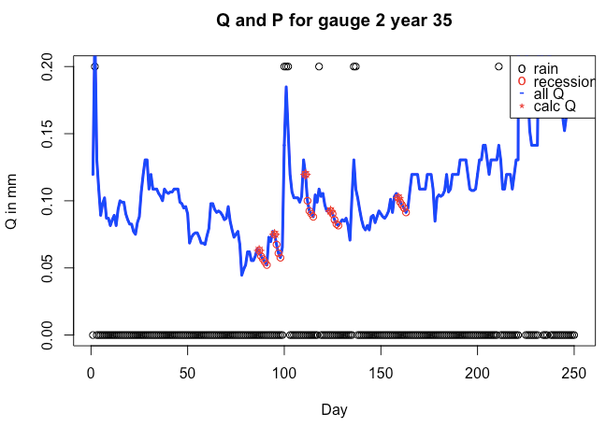
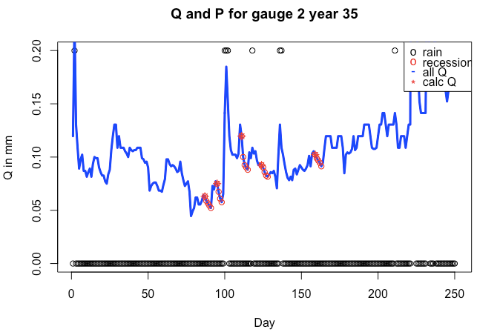
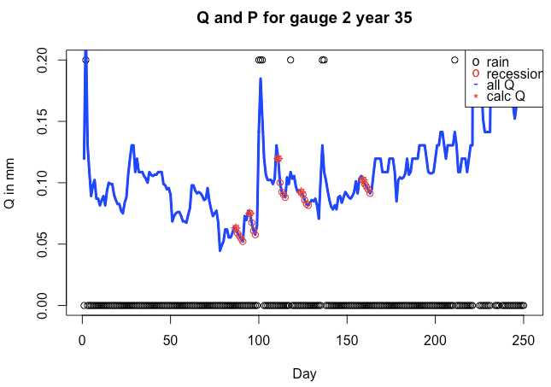
Power Law Validation.R
The unchanged version of a and b seems best overall, so (a,b) seems reasonable.
Experimenting with different a and b’s
a/10, 10*b
a, 10*b
10*a, 10*b
Unchanged a,b
a/10, b
10*a, b
a, b/10
10*a, b/10
a/10, b/10
When there’s no star on the plots (when b changes), it’s because we get NaN

Slide 12
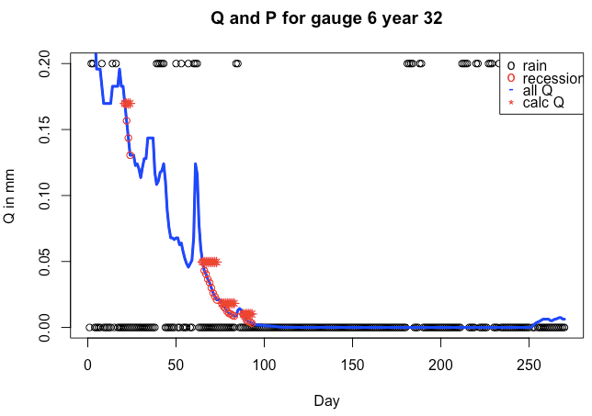
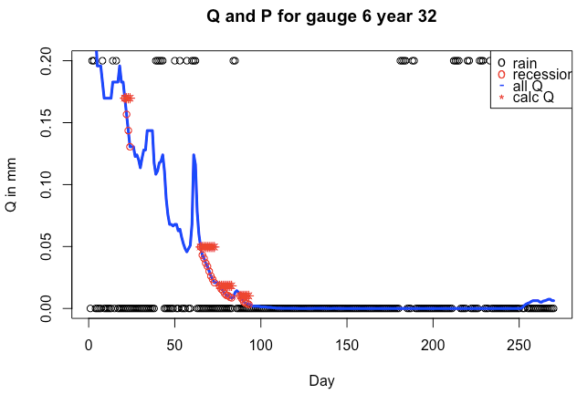

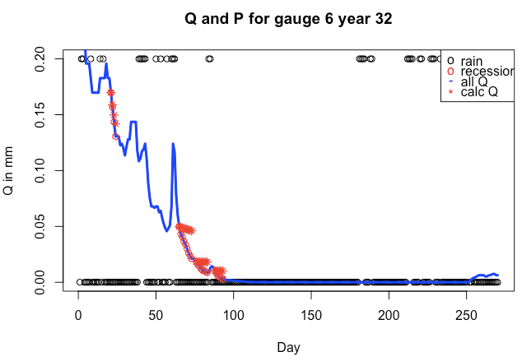
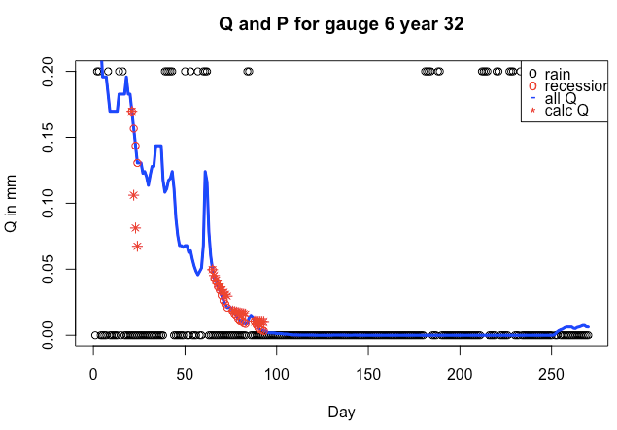
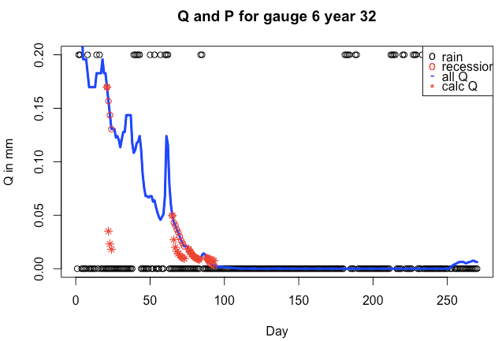
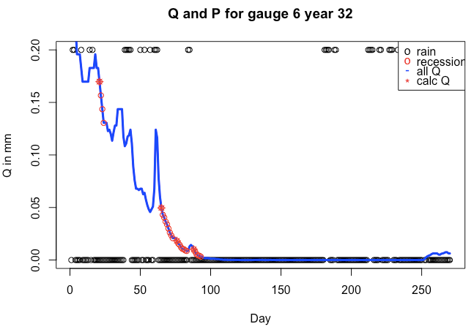
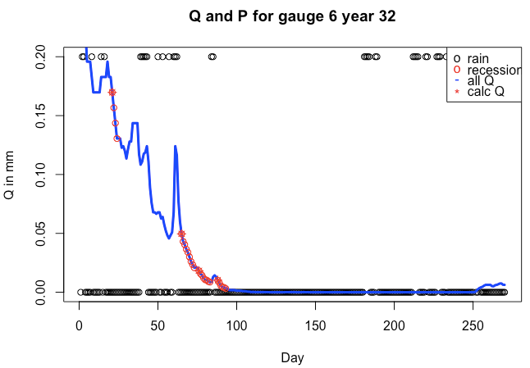
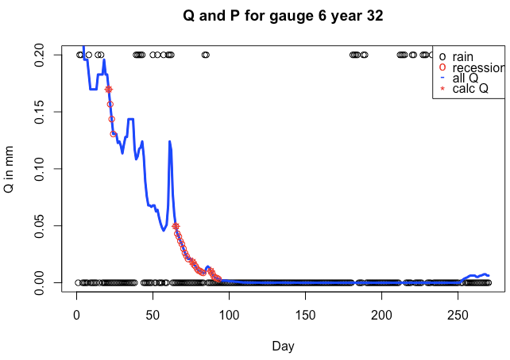
Power Law Validation.R
The unchanged version of a and b seems best overall, so (a,b) seems reasonable.
Experimenting with different a and b’s
a/10, 10*b
a, 10*b
10*a, 10*b
a/10, b
Unchanged a,b
10*a, b
a, b/10
10*a, b/10
a/10, b/10

Slide 13
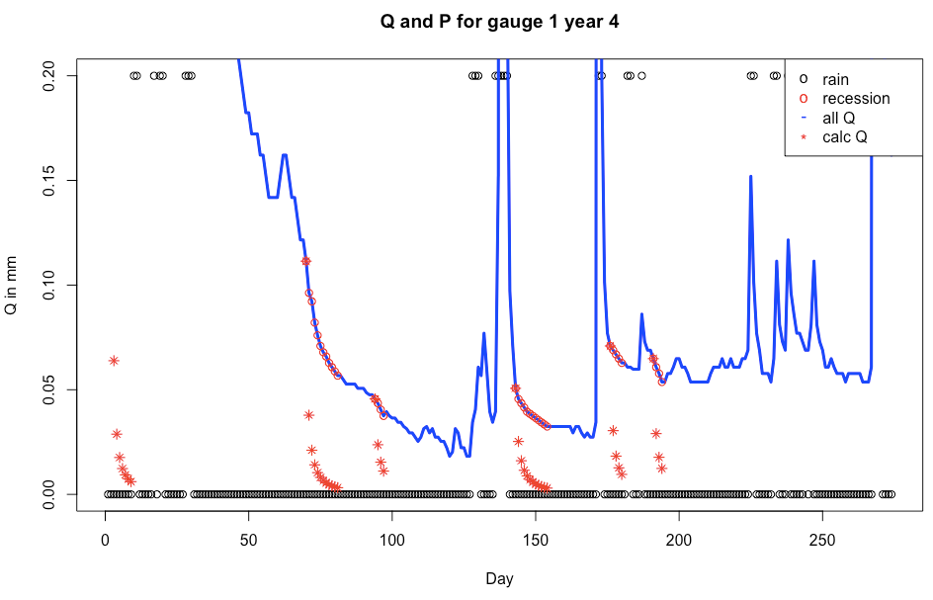
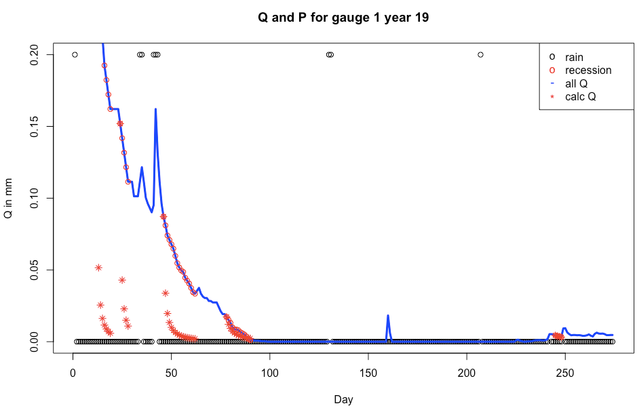
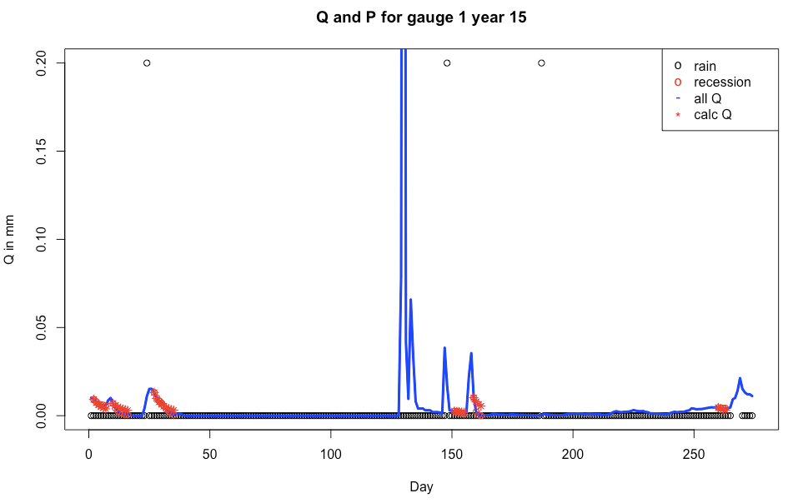
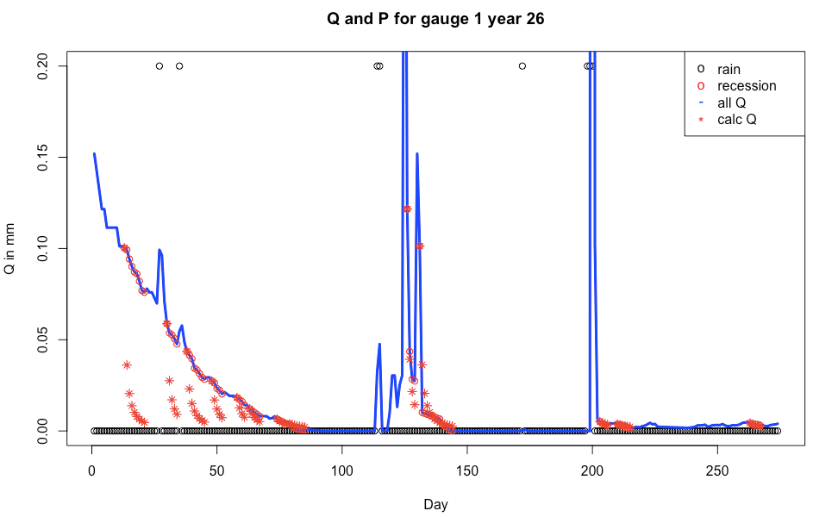
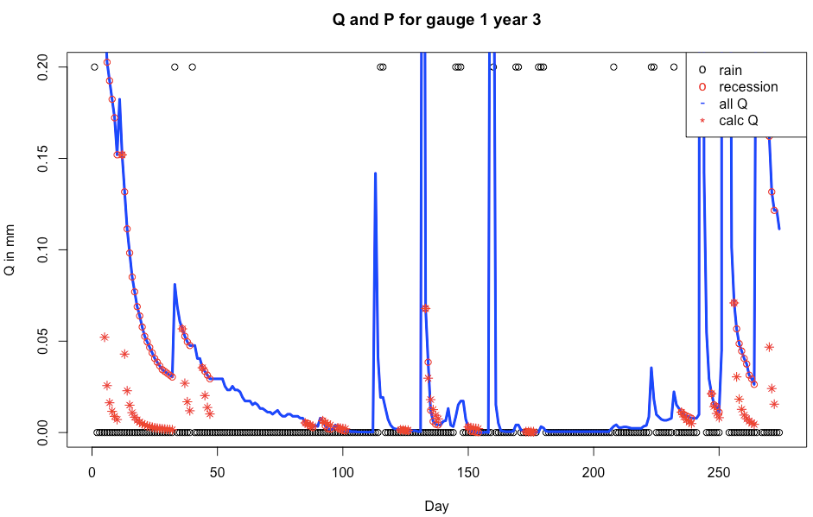
R code: Power Law Validation.R

Slide 14
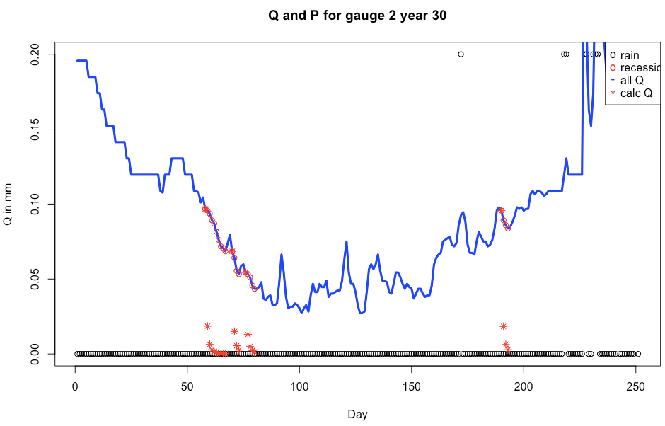
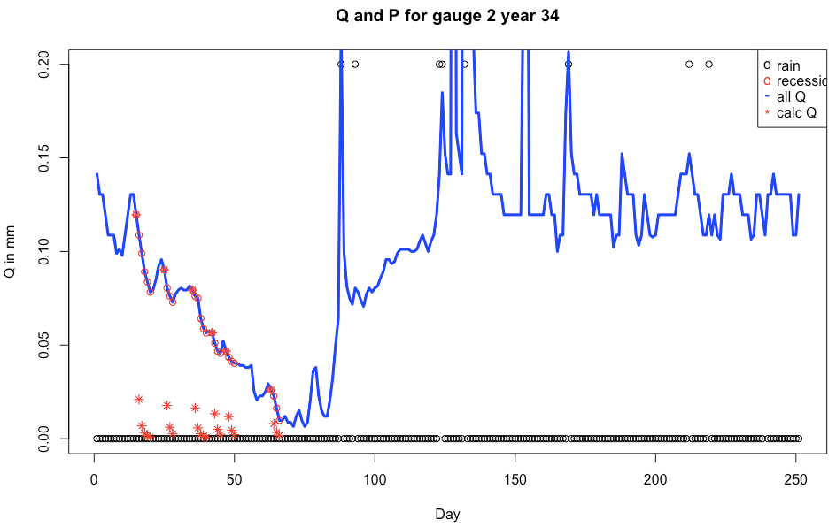
Gauge 2 doesn’t look like seasonally dry; none of the recessions match up.
R code: Power Law Validation.R

Slide 15
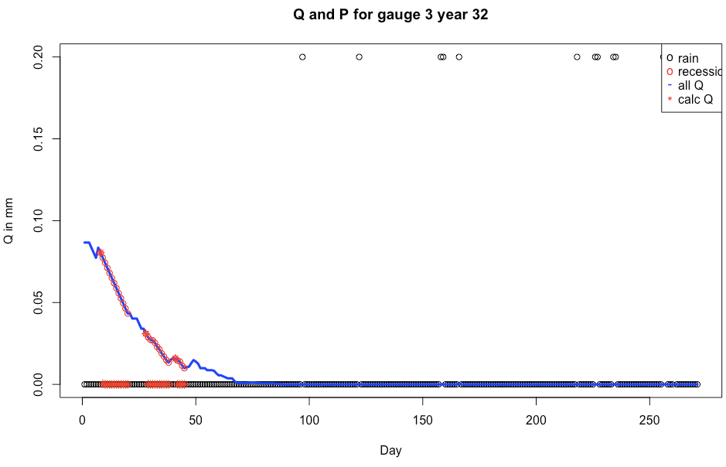
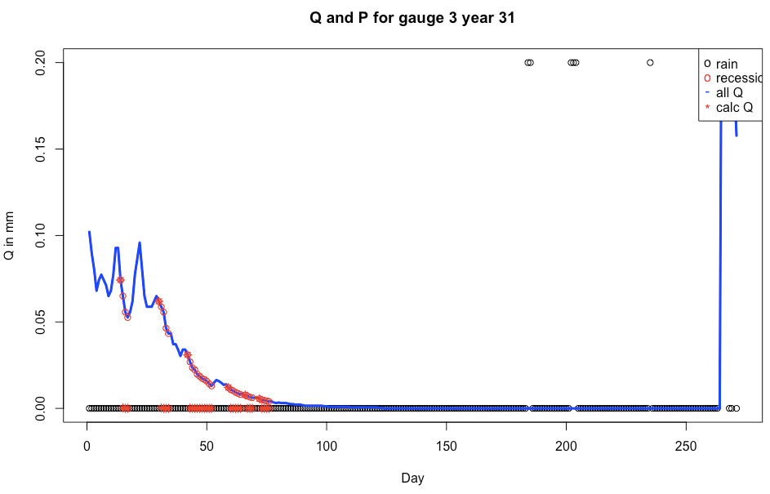
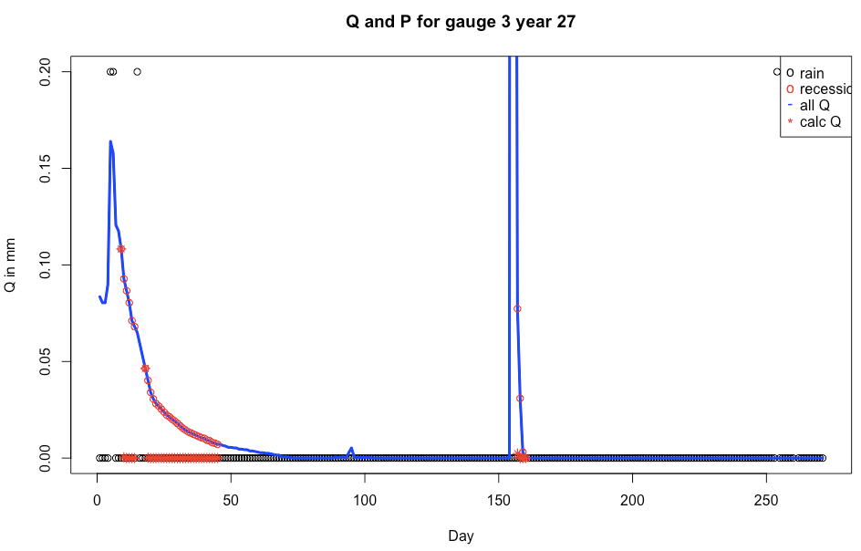
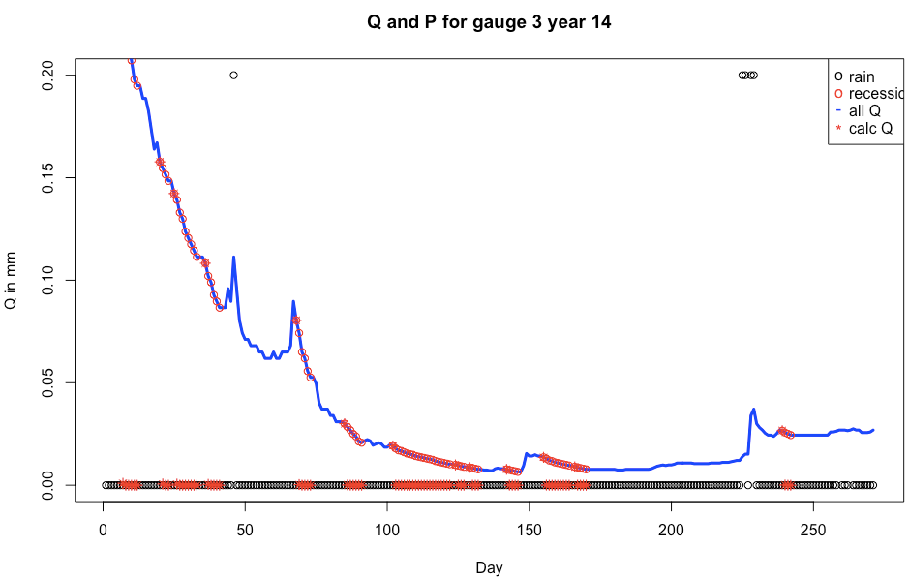
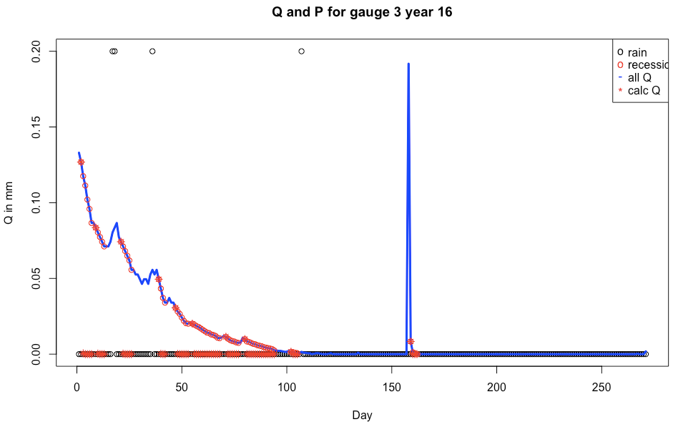
Gauge 3: no recession fits either; all calculations seem to decrease to zero immediately
R code: Power Law Validation.R

Slide 16
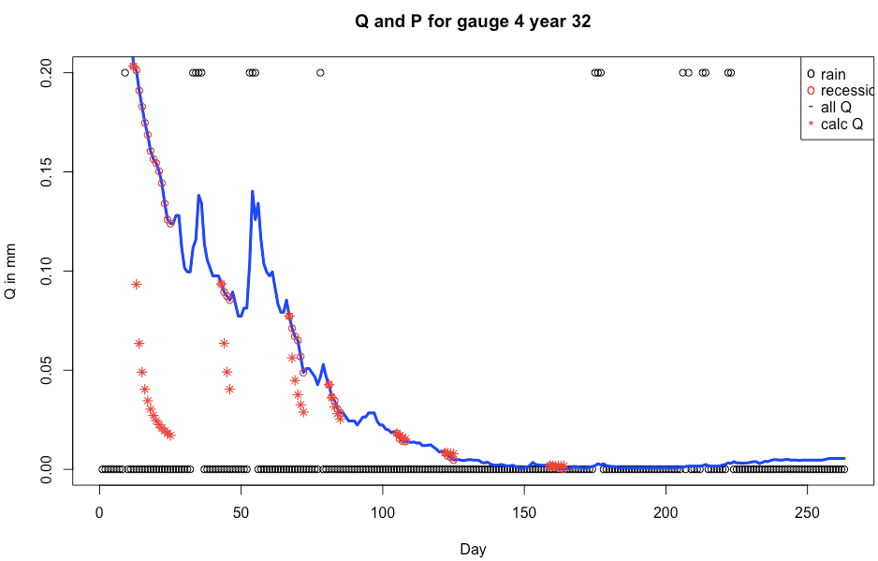
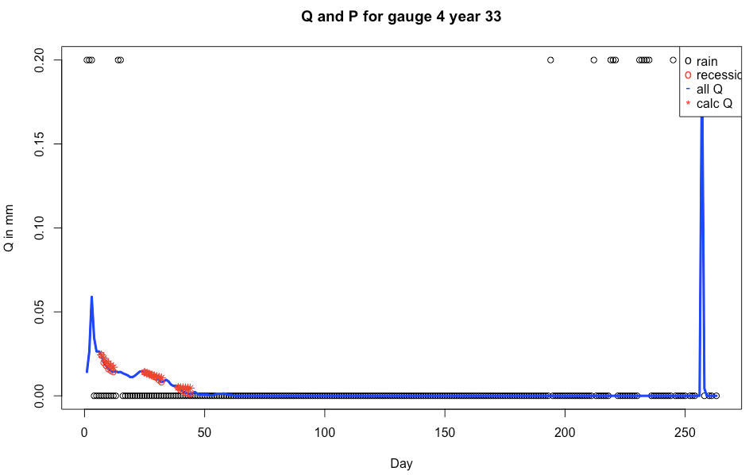
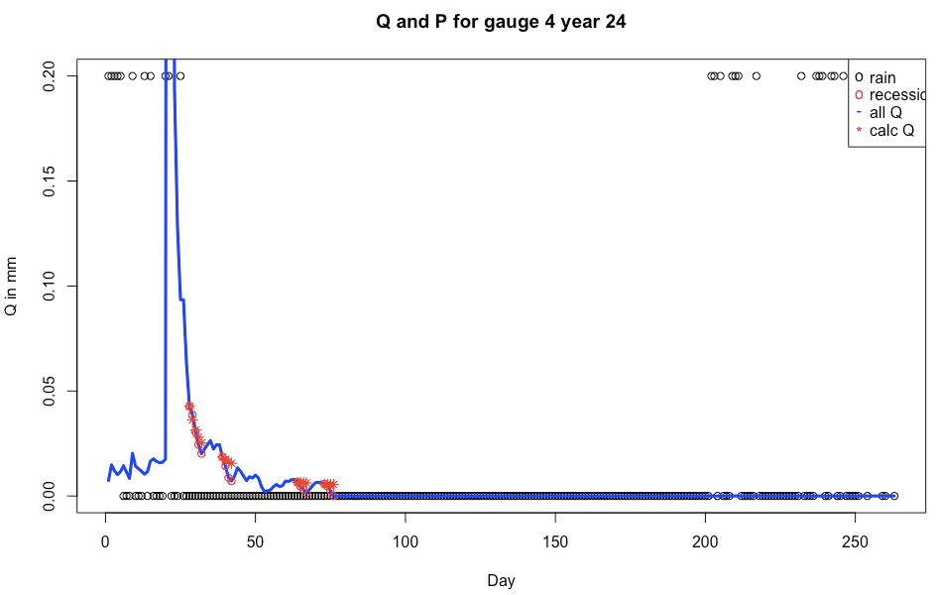
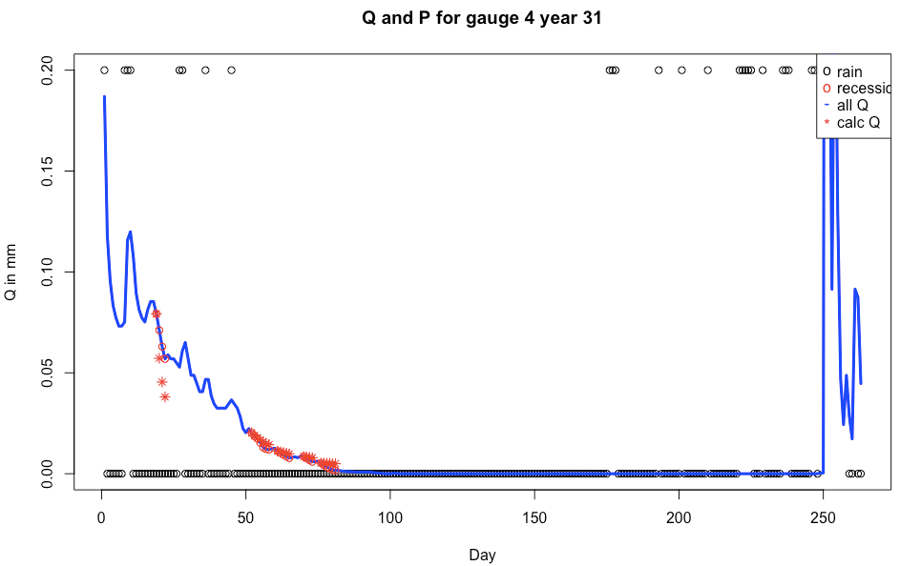
Recession agreement is ok for gauge 4
R code: Power Law Validation.R

Slide 17
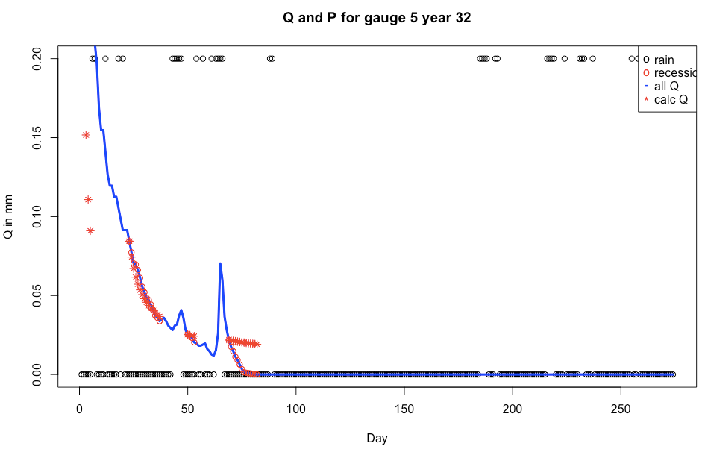
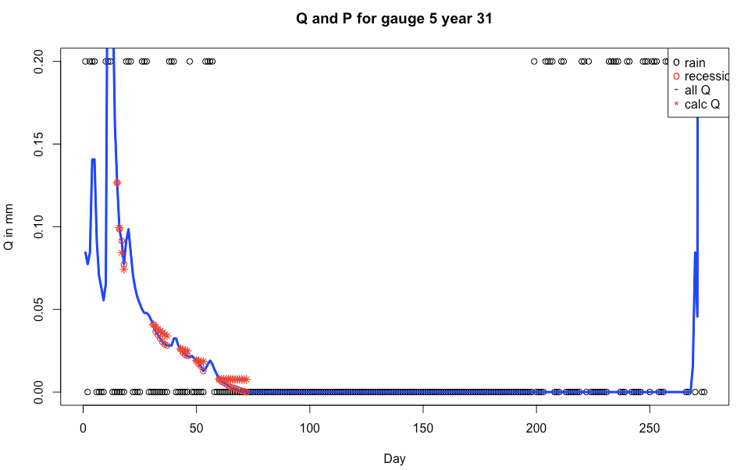
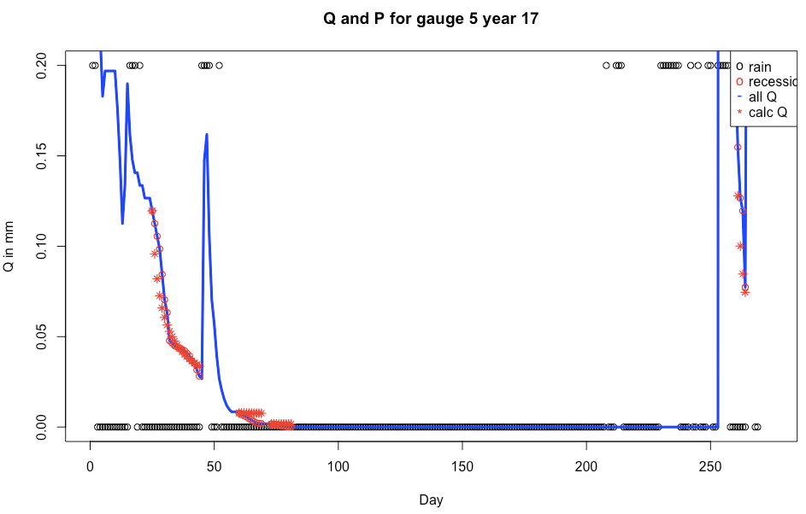
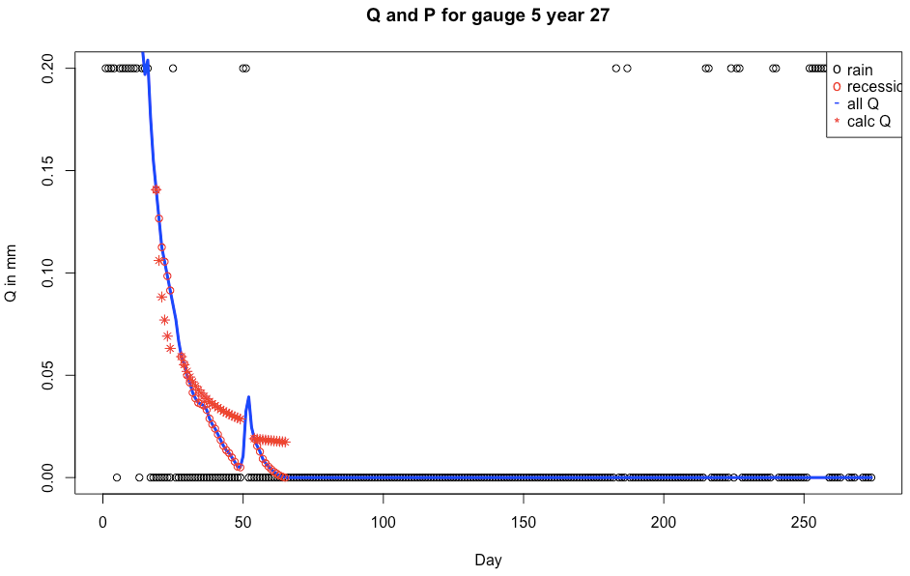
Gauge 5’s agreement is okay
R code: Power Law Validation.R

Slide 18
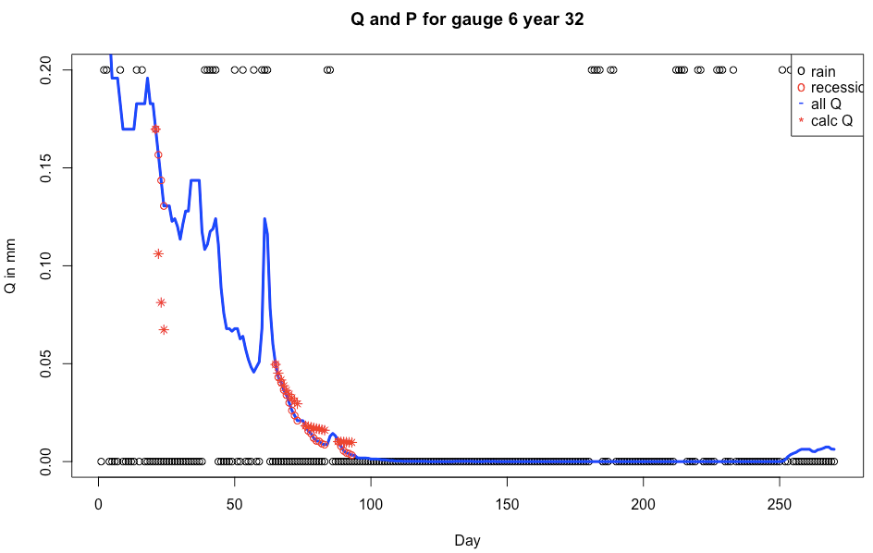
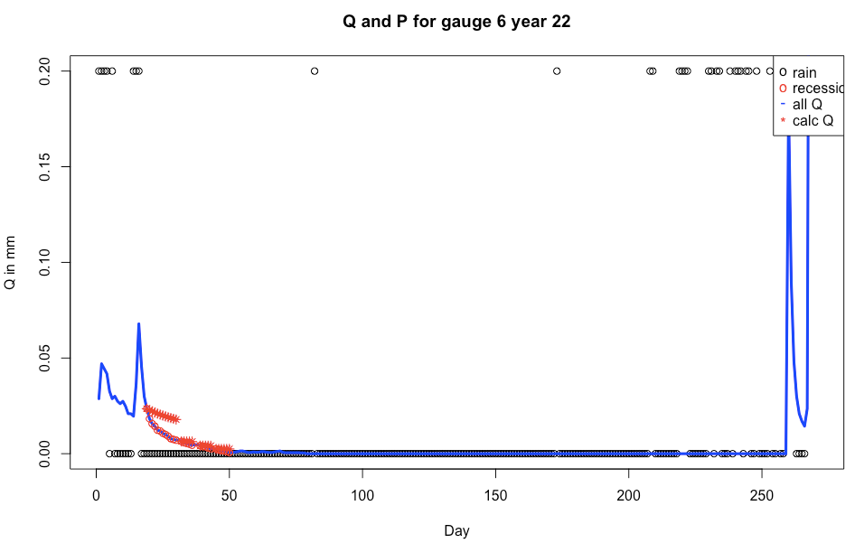


Agreement is ok for gauge 6
R code: Power Law Validation.R

Slide 19

Fix NSE stuff

Slide 20

(Carrillo et al, 2011)
They did catchment classification via process model. The model is based on the hillslope boussinesq equation, energy balance, and root zone water balance. Didn’t see any classification though…
NOTE that they separated the recession curve for hillslope Boussinesq aquifer vs. the deep aquifer. Look at their paper for reference on how to do this. Example is in Fig 2 below. The hillslope aquifer part is nonlinear recession, and deep GW part is linear recession.

Slide 21
(Feng et al., 2012) – seasonality
Seasonality of energy and P lead to problems in defining annual water balance, so they developed dimensionless numbers that govern annual water balance in seasonally dry basins. They use these dimensionless numbers in the stochastic soil moisture model to get analytic expressions for the water balance (i.e. get ET/R per year)
(Wolock et al, 2004) – delineation of HLUs
Delineation of HLUs in the US with GIS and statistics. Used metrics to quantify land surface form, geologic texture (bedrock and soil permeability), and climate; then use principal component analysis and cluster analysis to assign watersheds to their groups.
Used principal component scores to form HLR groups, then decide which groups mean what (i.e. plains and permeable soils, etc)
Note, Frenchman Creek was classified as permeable bedrock and lots of sand = “subhumid plains with impermeable soils and permeable bedrock”, which leads to the primary flow paths being overland flow and deep GW, NOT shallow GW!
(Winter) – HLUs
Defined HLUs from land surface form, geology, and climate. Therefore should encompass surface, GW and atmospheric water movement.
The fundamental HLU has an upland and lowland, as well as geologic framework and climate. Geologic framework examples: clay, sand, crystallline, carbonate.

Slide 22
(Yokoo and Sivapalan)
They separate the FDC into SFDC (surface FDC) and SSFDC (subusrface FDC) and use this to look at climate and landscape controls on FDC.
Unlike Botter, they use multiple runoff generation mechanisms in their process model; however, theirs is numerically based, which is less desirable than analytic, due to computation time and the ability to invert the model. Their model is solved numerically every 5 minutes.
They use a model to elucidate physical meaning of FDC, use model for classification of basins; for us, it’s the opposite – use indeces to determine when it’s appropriate to apply a model.
Provides concepts for constructing FDC from P, PET and soil type.

Slide 23
(Cheng et al, 2012)
Botter’s assumptions are: Poisson rainfall, and therefore can only be applied to a single season, and that season must be stationary. It ignores carryover of soil moisture storage, which is a problem if there’s high seasonality.
This study builds on Yokoo and Sivapalan, and generates regional patterns in FDC shape using statistics. Climate and landscape indices are regressed against gamma distribution parameters that describe the FDC. Suggests that parameters of FDC are primarily governed by climate, with secondary effects in landscape/geomorphology.
(Ye et al, 2012)
Their purpose was to use different model structures to predict the regime curve, and see which model structure does the best – to decide what the main runoff processes are for a basin.
Started with a simple two-bucket base model, which was then systematically enhanced with new processes until model performance couldn’t be improved. The base model has saturation excess Q and subsurface Q. the modifications were: snowmelt; subsurface induced fast flow (i.e. saturation excess), interception loss (veg. cover variability), and phenology (growth cycle of vegetation). Note that it didn’t look at deep GE flow…
Then, they classified the basins by what number and types of modifications were most important. Look at their maps and use as a guide to what types of Botter variations are most important in a given area. Except instead of their trying-models-out to find which processes dominate, we want to go directly to an index. But how will we find out what those indeces are?

Slide 24
(Coopersmith et al, 2012)
Uses decision tree to classify MOPEX basins, and found that seasonality plays most important role in US catchment classification – but they only accounted for P, ET and Q (not geology, etc). They emphasize that their method isn’t simply statistical like clustering, which doesn’t tell anything about physical drivers that contribute to similarity.
They used four indices in classification: aridity, seasonality, date of P peak, date of Q peak. To classify, split catchments into groups so that the regime similarity metric is minimized between groups. When classified via these four indeces, the regime curves of each cluster is similar.
(Yaeger et al, 2012)
Said that climate controls the middle part of FDC, but soils, geology and topography explain the extremes. Fast flow is controlled by P.
This paper synthesizes the gamma parameters of the FDC curve with the catchment classes and dominant processes from the previous three papers in this series. It maps dominant processes to the FDC parameters, and maps climate indeces to FDC parameters.
The regime curve is different from FDC because it contains the temporal pattern of ET, P and Q; whereas in FDC this information is removed. Therefore the regime curve makes it easier to see time-dependent catchment responses.

